Slide 1

North East Power Team
Business Plan
January 16, 2001

Slide 2
North East Power Team
Jeff Ader & Dana Davis
Dan Allegretti
Berney Aucoin
Mark Bernstein
T.J. Black
Paul Broderick
Michael Brown
Lisa Burnett
Larry Campbell
Tom Dutta
Howard Fromer Gerald Gilbert
    Joe Gordon
    David Guillaume
    Gautam Gupta
    Pearce Hammond
    Claudette Harvey
    Tom Hoatson
    Richard Hrabal
    John Llodra
    Tom May
    Jim Meyn
    Jeff Miller
    Narsimha Misra
    Ricardo Perez
    Steve Plauche
    Joe Quenet
    Janelle Scheuer
    Robert Stalford
    Chad Starnes
    Joe Stepenovitch
    Jennifer Stewart
    Paul Thomas
    George Wood

Slide 3
North East Power Team
Jeff Ader & Dana Davis
NEPOOL NYPP PJM
Marketers Traders Marketers Traders Marketers Traders
John Llodra Dana Davis-T Michael Brown Tom May-T Mark Bernstein Rob Benson-T
George Wood Paul Broderick-C Janelle Scheuer Rob Stalford-C Joe Gordon Joe Quenet-C
TBD Joe Stepenovitch TBD Larry Campbell Pearce Hammond Chad Starnes
Gerald Gilbert Gautam Gupta Lisa Burnett
Ricardo Perez Narsimha Misra
Jeff Miller
Dan Allegretti-- Regulatory Howard Fromer-- Regulatory Tom Hoatson-- Regulatory
C= Cash Traders T=Term Traders
* Tom Dutta-- NE Transmission * Richard Hrabal-- Mgr. NE Hourly Trading * Jim Meyn-- NE Structuring
* David Guillaume, Steven Plauche, and Jennifer Stewart support groups as needed

Slide 4
I. Primary Goals
Make/Exceed budget
Increase deal volume to meet transaction targets
Integrate trading, origination, structuring,
and marketing into one cohesive, effective, profitable team

Slide 5
II. North-East Regional Plan
Determine regional strategies
  Mid-marketers and Originators develop 2001 regional strategy ensuring alignment with respective traders’ strategy.
  Strategy will include
    specific goals
    action plan
    individual team member’s responsibility and accountability

Slide 6
II. North-East Regional Plan (cont.)
  Strategy will address the development of these markets:
    Options
    ICAP
    Ancillary services
    Cross commodities with specific focus on spark spread
    Other Enron products (paper, weather, emissions, etc.)

Slide 7
II. North-East Regional Plan (cont.)
Ensure timely and effective communication
  Weekly North East Power Team meetings with the following agenda:
    Trader update, including market fundamentals
    Deals: executed, current, and prospect
    Accomplishments/Issues/Problems

Slide 8
III. Trading Goals
Meet/Exceed budget
Promote unified trading, marketing, and origination team
Increase market liquidity and trading volume
Create options capability
Establish other financial products
Develop transmission rights trading

Slide 9
III. Trading Goals
Develop physical desk for managing long-term strategic physical deals
Develop an IT system to more effectively manage physical deals
Develop markets in non-energy products
Clearly define and communicate strategic direction to entire team
Assist in strategic directional transactions
Develop long-term price curves

Slide 10
III. Trading Goals
Institute additional pricing points
Develop models for:
  Price forecasting
  Stack analysis
    by zone
    by fuel type
  Transmission system
  Imports/Exports

Slide 11
IV. Marketing Goals
Meet/Exceed budget
2001 Goal: 200 Transactions
Increase market information and liquidity
Uncover and relay strategic opportunities to originators

Slide 12
V. Marketing Plan
Assign regional expertise to each power pool
Increase customer base, including industrials
  Prioritize customers
  Increase focus on industrials
Build and reinforce strong customer relationships
  customer education/ seminars
  newsletter distribution
  develop and distribute marketing materials
  increase daily contact

Slide 13
V. Marketing Plan (cont.)
Tactical customer coverage
  Track coverage metrics
  Institute central mid-market phone number for each region to facilitate customer access
Expanded product offerings
  Option hedges
  Financial hedges
  Unit outage insurance
  Surrogate hedges

Slide 14
V. Marketing Plan (cont.)
Execute master agreements
Increase EOL sign-ons
Leverage mid-market skill set with originator skill set to optimize customer value
Supply market intelligence to traders
Understand ISO rules, procedures, and issues

Slide 15
VI. Origination Goals
Meet/Exceed budget
Unite trading, mid-marketing, and origination
One outsourcing/ asset management transactions in each region
Negotiate strategic partnership with key players in region
Uncover and relay commodity transactions to mid-marketers

Slide 16
VI. Origination Goals
Develop and promote pool liquidity
  Regulatory issues
  Market Power issues
  Risk management strategies
Develop personnel and effectively promote knowledge transfer
Find and develop new businesses

Slide 17
VII. Origination Plan
Assist trading and mid-marketing in determining ENA’s strategic view of each region as it relates to load and generation
Build/maintain/further relationships with senior customers
Consistently survey market for opportunities

Slide 18
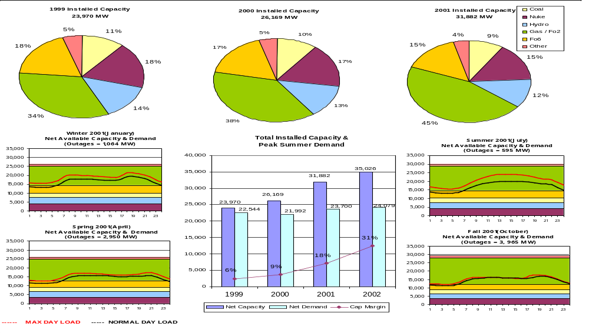
NEPOOL

Slide 19
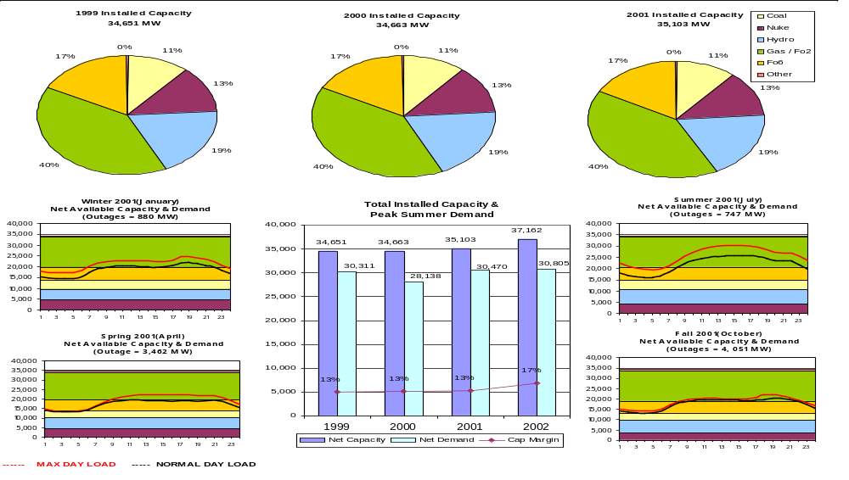
NYPP

Slide 20
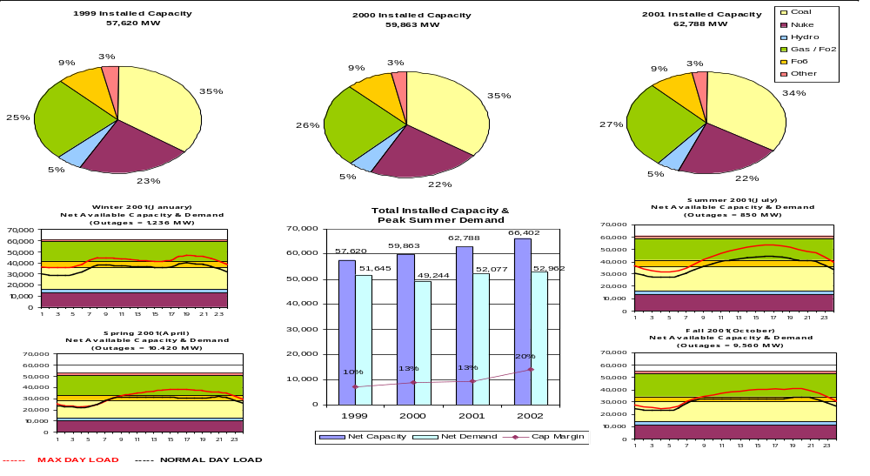
PJM

Slide 21
North East Power Marketing Customers

Slide 22
North East Power Generation

Slide 23
North East Power Industrials

Slide 24
North East Power Generation-- PJM

Slide 25
North East Power Generation-- NEPOOL

Slide 26
North East Power Generation--NY

Slide 27
North East Power Customer List-- PJM

Slide 28
North East Power Customer List
NEPOOL

Slide 29
North East Power Customer List
New York

